Slide 1
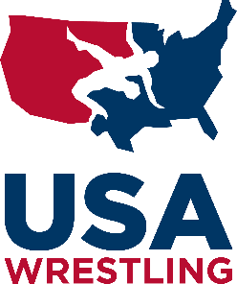
NFHS Wrestling
2023 PRACTICAL UNIFORM GUIDE FOR GIRLS
One-Piece Uniform Rule for Girls
Optimal One-Piece Uniforms for Female Wrestlers
Athletic Equipment For Girls Includes Sports Bras
Resource for Coach, Parent, and Official

Slide 2
NFHS Member State Association Wrestling liaison - How You Can Help
It is important that each state association wrestling liaison use the information in this practical guide as a resource to share with your member schools OR create your own.
Your wrestling coaches need continuing education on health and sports related issues for their female wrestlers.
We recommend the wrestling community reach out to wrestling uniform manufacturers and encourage them to create or improve equipment designed for the growing NFHS girls wrestling community.
Keep the conversation on improving the required uniform and reduce the focus on the individual athlete when it comes to addressing issues.

Slide 3
NFHS Rule: One-Piece Uniform
Rule 4, Section 1, Article 1a Note:
“Female contestants wearing a one-piece singlet shall wear a sports bra that completely covers their breasts and minimizes risk of exposure.” (NFHS Rule Book 2022-2023)
This rule is designed to address two important needs for the female wrestler:
A sports bra is a critical piece of equipment for girls in athletics and is required for female wrestlers in competition.
The one-piece uniform and sports bra should maintain a level of performance during wrestling competition consistent with risk minimization standards for all NFHS sports.
Reducing or eliminating exposure is one example of safety standards prioritized for all male and female NFHS athletes.

Slide 4
What is an optimal One-Piece Uniform for girls?
We encourage every school to invest in quality girls’ one-piece uniforms.
Purchase from trusted wrestling uniform manufacturers that have invested in creating one-piece uniforms specifically for girls.
Purchase from companies that understand the NFHS rules for girls.
Ask for a sample of each size from the company you are considering for your uniform purchase.
The use of boys’ one-piece uniforms by female student athletes is not advisable. The front and sides are too low to meet the needs of female wrestlers during competition.
The use of a compression shirt with a singlet should be the choice of the athlete, not a remedy for poor one-piece uniforms or lack of assistance for an optimal sports bra.

Slide 5
Sports Bras
Sports bras are a piece of sports equipment designed to meet the needs of girls in athletics.
Scholastic wrestling leaders need to be confident in discussing all aspects of the NFHS uniform rules including sports bras.
In a full contact sport like wrestling, it is critical for every girl to have a sports bra that works for her individual needs for competition.
Sports bras should not be a barrier to girls' participation in wrestling
because of economics, access, or excessive rules.

Slide 6
What is an optimal sports bra for wrestling?
With girls’ weight classes ranging from 100 lbs. to 235 lbs., wrestling is creating inclusive opportunities for females in scholastic sports. One sports bra will not meet the needs of all girls competing in wrestling.
A quality girls’ one-piece singlet and sports bra needs to perform well for female wrestlers during competition not during skin check and weigh-in.
An optimal sports bra for wrestling meets each individual girl’s needs and meets the safety standards of the NFHS to reduce or eliminate unnecessary exposure.
A traditional cut sports bra will perform well for many female wrestlers during competition. For other wrestlers, we recommend coaches, parents and students become familiar with a high cut sports bra. A high cut sports bra extends higher in the front and under the armpit.

Slide 7
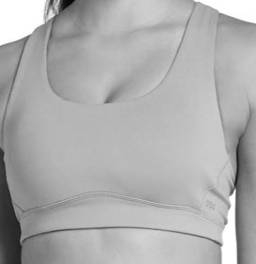
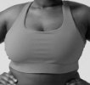
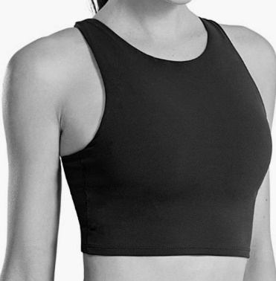
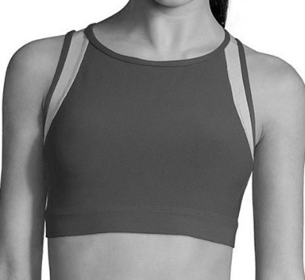
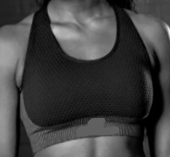
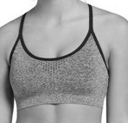
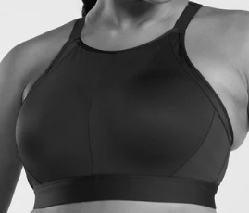
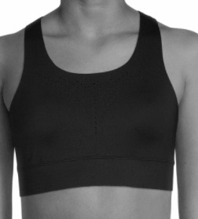
sports bra for wrestling
Examples of traditional or basic sports bras
Examples of high-cut sports bras

